Slide 1
Small Town Issues
Ben Tafoya, Director
Special Projects Research
Jana DiNatale, Director Division of Local Mandates
June, 2023

Slide 2
Established by Proposition 2 ½
Responds to mandate determination requests
Conducts municipal impact studies
Certifies expenses for reimbursements deemed to be unfunded mandates (such as early voting and uniform polling hours)
About the Division
of Local Mandates
(DLM)

Slide 3
Mandate Determinations
Process begins with a petition from Mayor/City Council/School Superintendent/School Committee or equivalents in a community
Petition is in form of a letter to the Auditor
DLM staff conducts legal and financial analysis of the petition
Auditor DiZoglio and DLM offer a determination letter
DLM has completed over 500 determinations over the years
Courts and Legislature have refined the process

Slide 4
PILOT reimbursements dependent on property value growth and equalized valuations
State-owned land (SOL) revalued biannually
Some leftover effects on how SOL was valued before Municipal Modernization Act
Payments allocated by % of total statewide value of SOL
Land in the program is largely concentrated in Western MA
State-Owned Land
PILOT Program

Slide 5
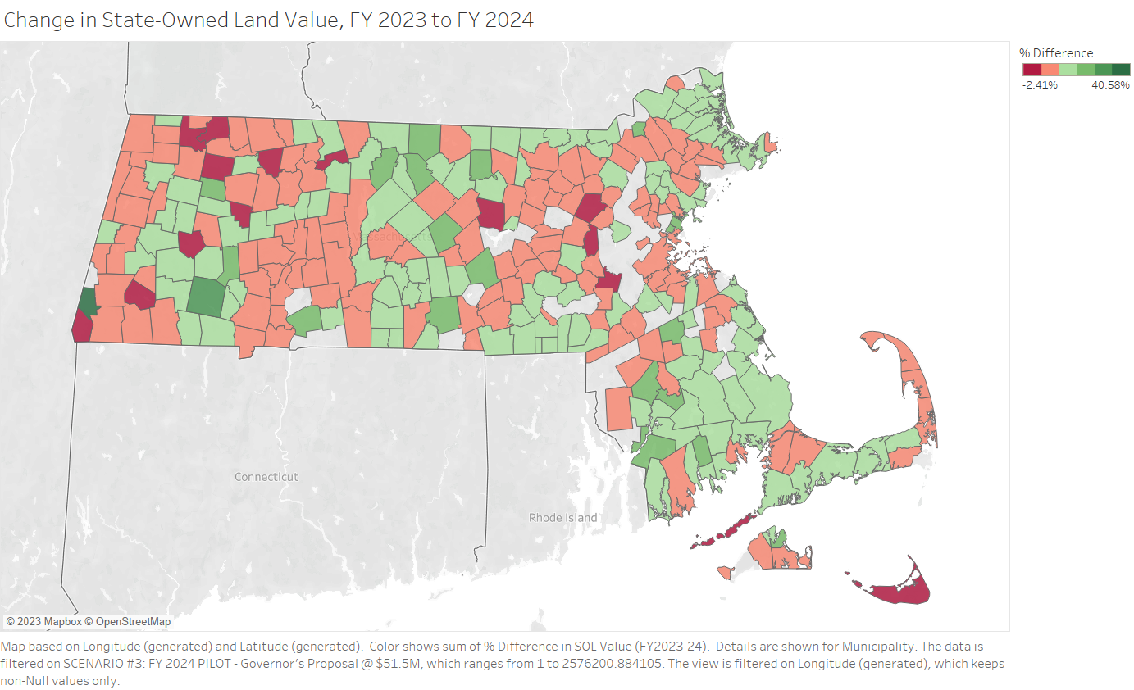
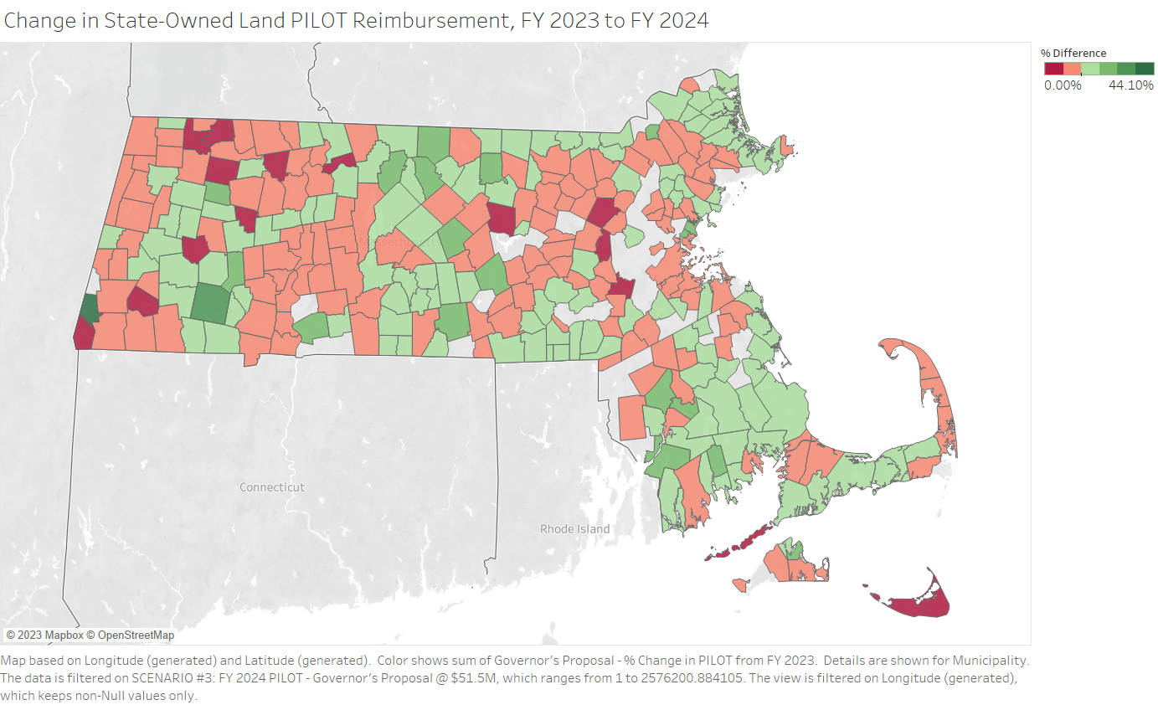
The rate of growth in state-owned land values influence the growth in PILOT reimbursements.

Slide 6
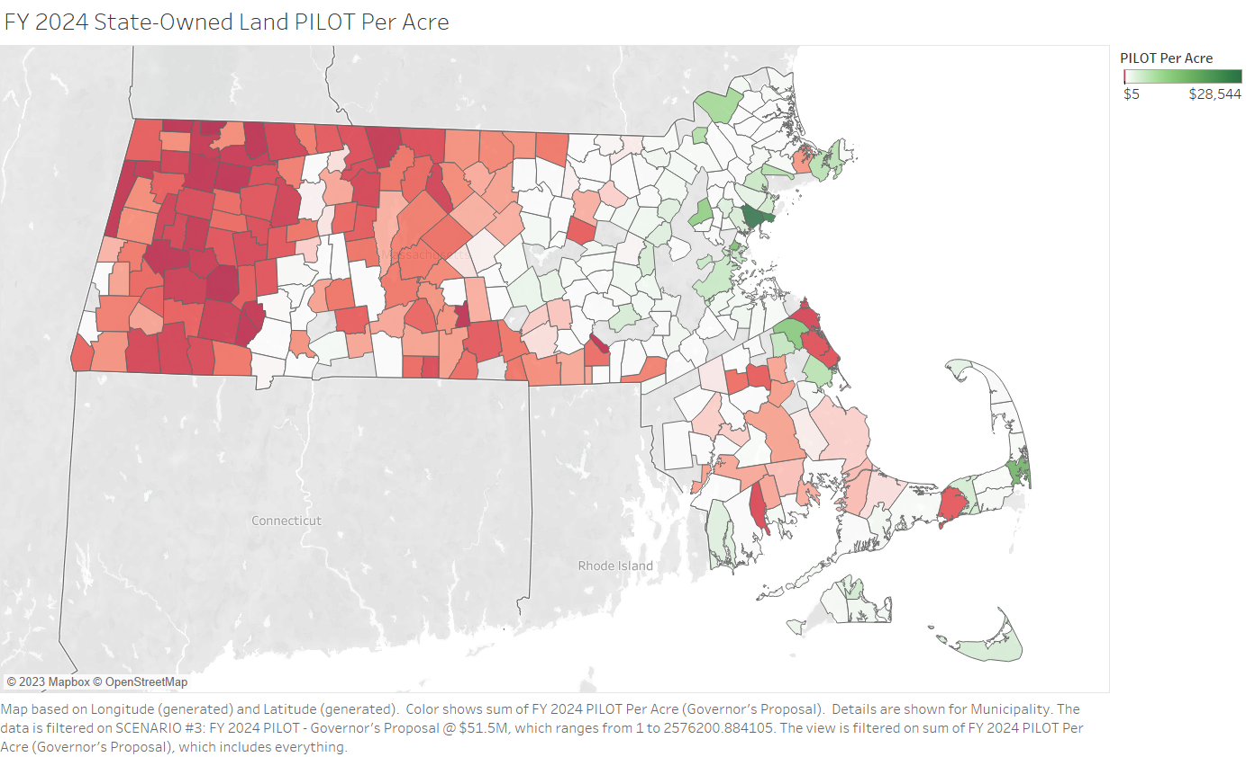
Varied reimbursements in cities & towns
Projected median PILOT reimbursement in FY 2024: $125 / acre
Western, Central and SE Mass communities likelier to be receiving payments below the median

Slide 7
Highest:
Suffolk - $4,726 / acre
Nantucket - $3,059 / acre
Dukes - $692 / acre
Middlesex - $310 / acre
Lowest:
Hampshire - $55 / acre
Hampden - $51 / acre
Berkshire - $29 / acre
Franklin - $28 / acre
What counties receive
higher reimbursements
for their state-owned
land?

Slide 8
Community comparison: Plymouth and Savoy
Most of their acreage comes from state forests
Plymouth – Myles Standish
Savoy – Savoy Mountain
PILOT payments are drastically different
Plymouth – $89 / acre
Savoy - $10 / acre
 | Number of State-Owned Land Acres | FY 2023 PILOT Payment | Per Capita Income (2020)
Plymouth | 11,885 | $ 1,054,067 | $ 44,583
Savoy | 12,198 | $ 118,661 | $ 33,253

Slide 9
Using a local tax rate:
Used by MWRA to give watershed payments
May show discrepancies in communities with similar # of acres
Carbon sequestration factor:
Communities w/ lower SOL values have large amounts of forested land, $50/acre floor
Potential Solutions

Slide 10
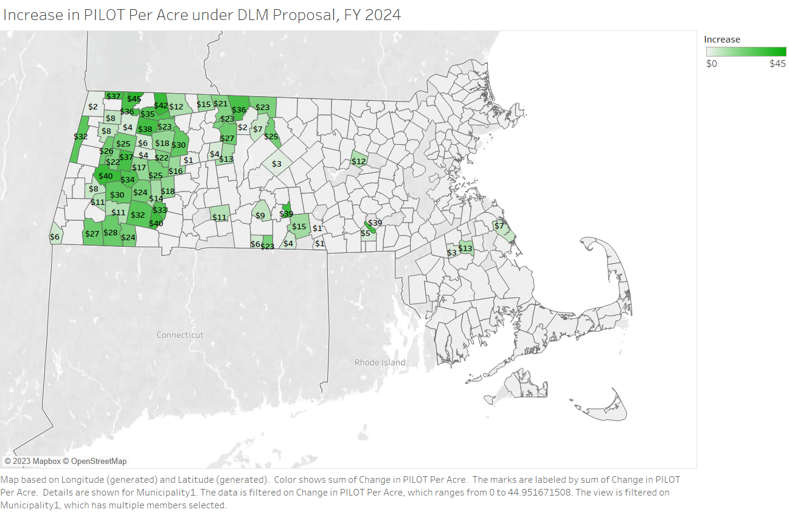

Slide 11
Chapter 90 Roadway Funding
Critically important source of state aid to municipalities for roads, sidewalks, and water crossings
Appropriation stuck at $200 million annually and hurt by inflation
Popular with municipalities because of flexibility in project spending
MMA and DLM research identified need for over $500 million per year
Program uses roadway miles as factor to help communities with large mileage

Slide 12
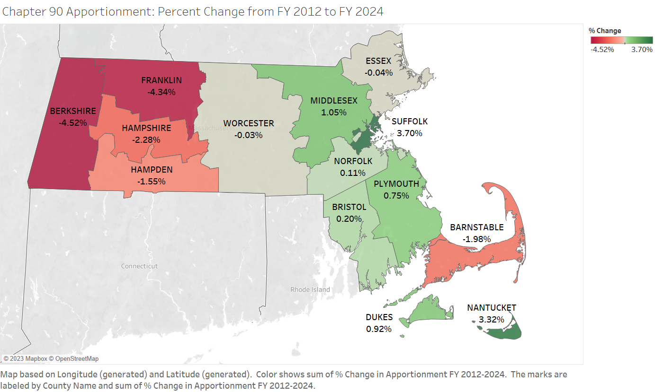

Slide 13
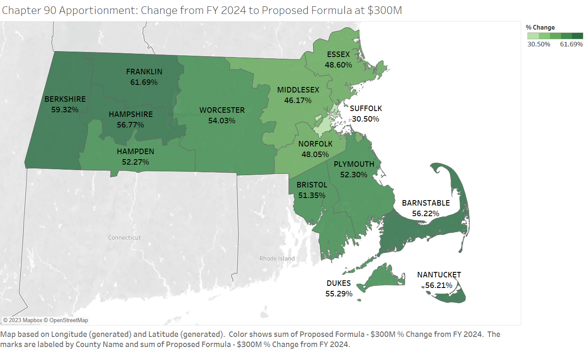

Slide 14
Municipal and Public Safety Building Authority
DLM survey found high need for municipal and public safety building repair, renovation or construction across the Commonwealth
Identified tens of millions of dollars required per year in just Western Massachusetts
Members of the Legislature have offered bold bills that offer structure and dedicated funding
S. 1303 (Sen. Kennedy)
S. 1489 (Sen. Comerford)

Slide 15
Special Education Expenses
Increase for tuitions approved by OSD at 14%
Big increase in wage allowance
Examining process and impacts
Financial relief?
In-district and out-of-district transportation also increasing with inflation
Shortfalls with Circuit Breaker funding

Slide 16
Transportation for Regional Schools and Voc-Tech Districts
Reimbursements vital for rural districts with large service areas / travel times
On track to be nearly fully funded under FY 2024 budget proposals
Rural school aid

Slide 17
Ben Tafoya, Special Projects Research Director
(857) 310-1492
Ben.Tafoya@sao.state.ma.us
Jana DiNatale, Director of Division of Local Mandates
(617) 694-6296
Jana.DiNatale@sao.state.ma.us
Mass.gov/Auditor
Twitter: @MassAuditor

