Slide 1
Age- and Dementia-Friendly Initiative
In Conway
February 13, 2023

Slide 2
We are here!

Slide 3
8 Domains of Livability

Slide 4
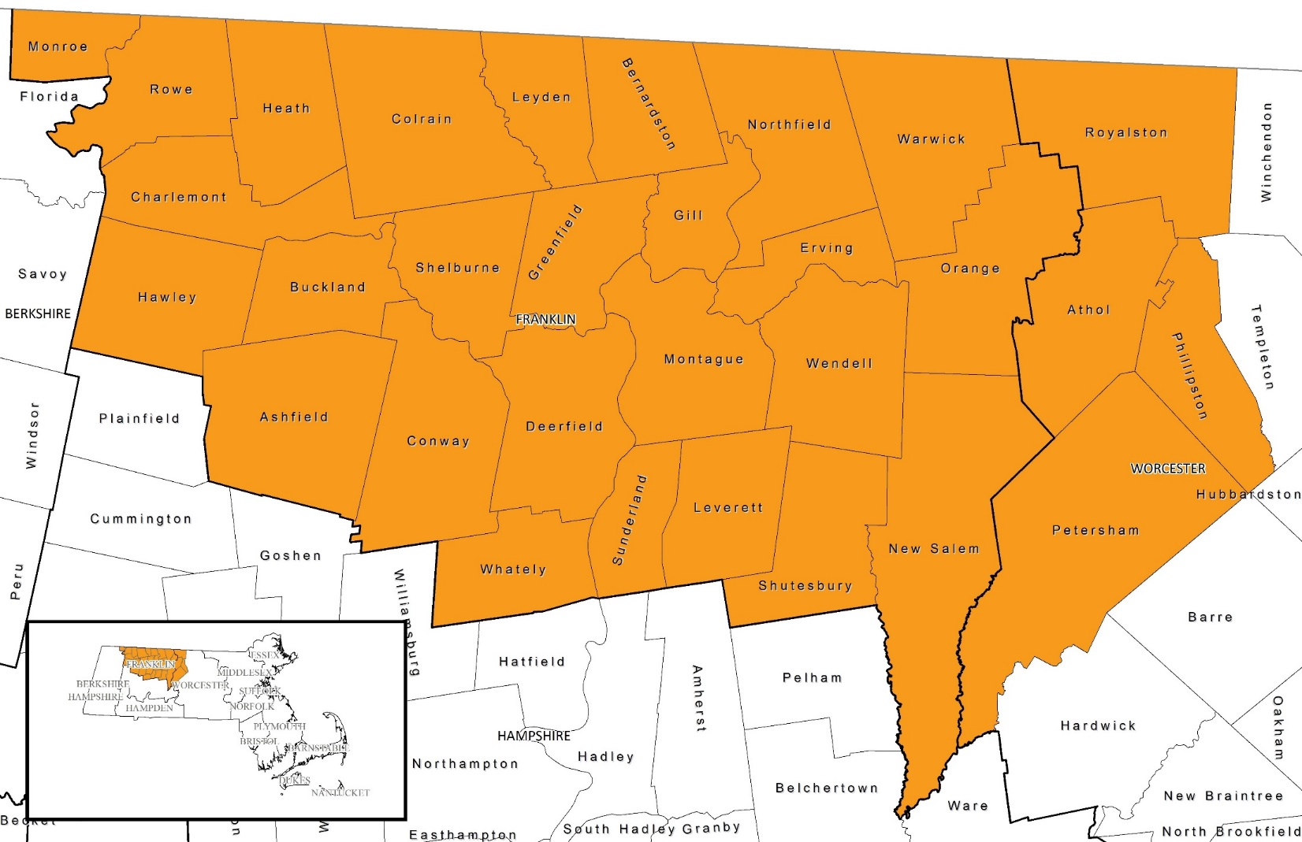
Enrollment Status for Area Towns
= joined the network
= in process of joining
Updated 2/7/2023

Slide 5
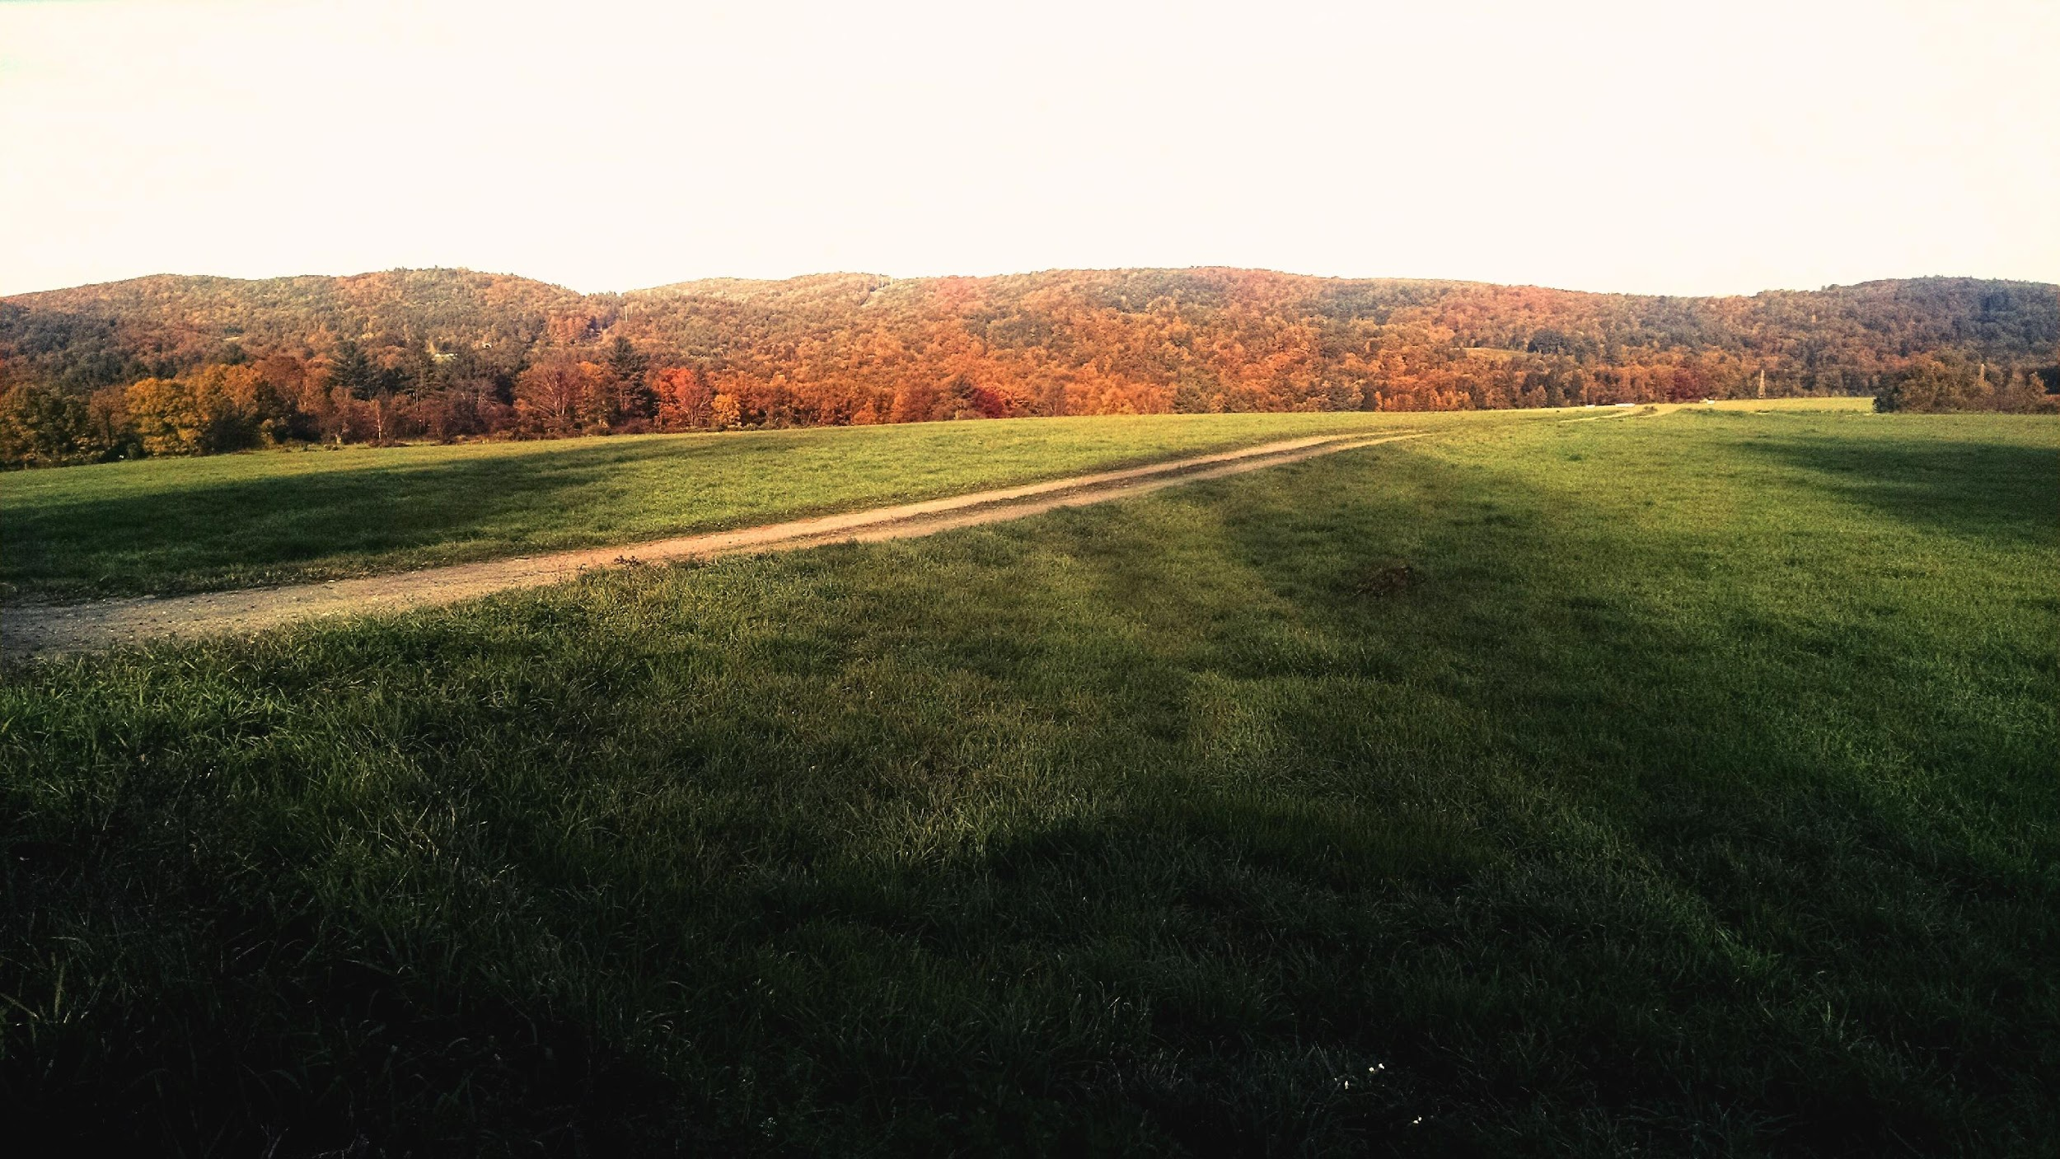
Age- and Dementia- Friendly Franklin County Needs Survey Responses
Throughout slides:
Region wide info is given first,
TOWN specific info is listed second in red parentheses.

Slide 6
Demographics of Survey Respondents
72% female, 25% male, 2% prefer not to say (76% female, 22% male)
25% live alone (23% live alone, 56% w/spouse or partner)
72% between ages of 60 and 79 (70% )
14% 80 or older (21% 80 and up)
14% 50 to 59 or caregiver ( 9% 50-59 or caregiver)

Slide 7
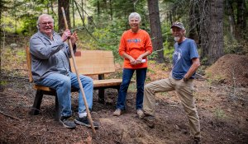
Built Environment: Housing, Public Buildings and Outdoor Spaces, and Transportation

Slide 8
Housing
47% (58%) of respondents own their own home
67% (77%) of respondents have lived in their current town for over 15 years (60% (75%) in the same home)
90% (93%) reported that it was important for them to stay in their town as they age, and 88% (88%)in their home.
33% (15%) reported good or excellent access to affordable housing options for people with their income level
Motivations for changing housing in the future:
cost 52% (60%)
need for different type of housing 43% (50%)
need for better access to transportation (27%) (26%)
cost of living in the area 26% region wide (21%)
need for better healthcare services 19% (12%)
need to be closer to family, social opportunities 29% (29%)
Maintenance: respondents reported generally good access to home repair services (58%, 72%) and lawn care (53%, 49%), a quarter report it to be unavailable

Slide 9
Outdoor Spaces and Buildings:
77% (83%) respondents report good access to public buildings for their current needs
39% (42%) either don’t have access or don’t know if they have access to outdoor spaces that are accessible to them and have adequate benches
49% (45%) of residents reported need for better lit and accessible streets and roads
69% (48%) of respondents report good traffic signs and pedestrian crossings – 31% (53%) report them to be poor or they don’t know
81% (85%) of respondents report always feeling safe in their home and community
“Both local little grocery stores have steps to enter. No handicap access.”

Slide 10
Transportation
Need for more access to transportation was the #1 issue mentioned in open responses
27% (26%) of older adults identified a potential need to change housing to get better access to transportation
86% (95%) drive themselves
24% (27%) have others drive them
23% (9%) walk or bike
3% (0%) report using special transit like Senior Center van
37% (96%) of respondents report there is no public transit in their area or it is too hard to get to
“If someone is sick, they have to rely on a friend to take them to the doctor or to run an errand.”
10

Slide 11
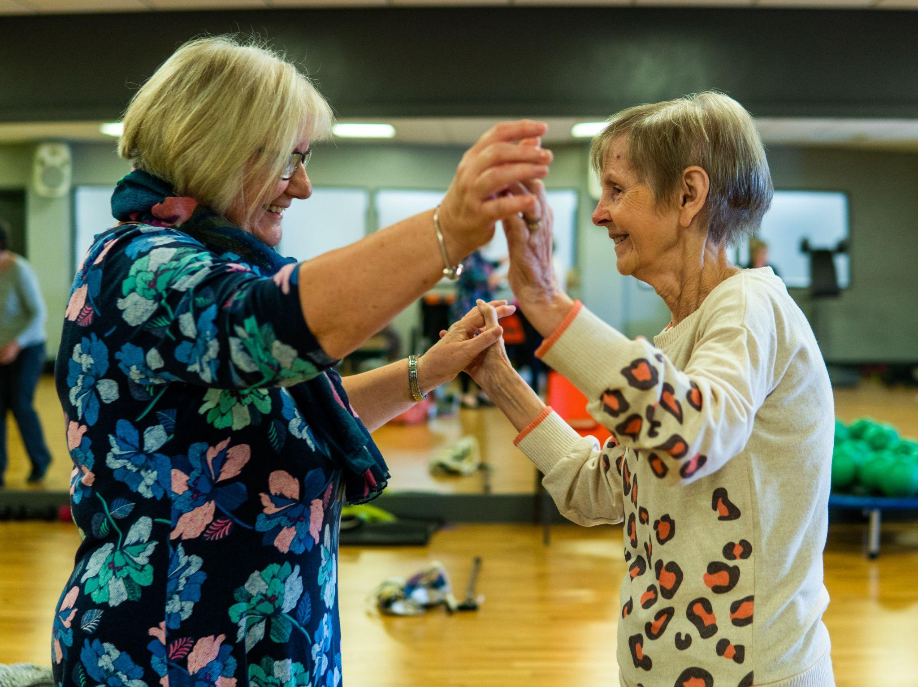
Social Environment: Communication and Information, Social and Civic Participation, Health Services and Community Support, Social Activities

Slide 12
Health Services and Community Supports
Health Services:
13% (7%) of respondents receive caregiving support
4% (5%) are primary caregivers of children
10% (10%) are the primary caregiver for an older adult
22% (19%) of respondents report access to adequate caregiver support (respite care, support groups)
26% (22%) of respondents say access to home health care providers is poor or unavailable
“As I start to have more health issues I am concerned (including cognitive issues). If anything happened to my husband, I'd be lost.”

Slide 13
Health Services and Community Supports
Health Services
34% (30%) of respondents say access to healthcare professionals is poor, unavailable, or they don’t know
37% (45%) say health and social services are not conveniently located or they don’t know
43% (30%) of respondents report access to wellness programs such as nutrition, pain management, etc.
79% (83%) of respondents report lack of access or don’t know access to mental health supports
“Good healthcare choices are extremely hard to find, and very hard to get anyone within a reasonable distance of travel.”

Slide 14
Health Services and Community Supports
Community Supports
Village or Neighbor to Neighbor support groups:
44% (54%) of respondents are interested in volunteering in a Village support group
31% (38%) are interested in receiving support from a Village support group
Information about Services
49% (44%) report good access to easy-to-find information about services

Slide 15
Health Services and Communication
Telehealth
72% (61%) of respondents have used telehealth at least once, 59% (48%) more than once
Of those who used telehealth at all:
70% (74%) had a good experience
59% (62%) would prefer to see their provider in person
90% (100%) found the technology was not confusing to use
86% (97%) would choose to use it again, even after pandemic
Focus Group/Open Response Themes:
Technical support needed to use telehealth services
“I would use telehealth again in the future, even after the pandemic.”

Slide 16
Social Participation
34% (28%) of older adults live alone, 52% (58%) live with a partner or spouse, and 10% (7%) live with family or friends.
77% (76%) of respondents interact with someone outside of their household several times per week or more
8% (10%) interact with someone outside of their household less than twice per month
83% (89%) sometimes or often feel well supported
20% (25%) do not have or are unsure if they have someone they can call for help anytime of day or night
Sense of community belonging is an unmet need for older adults
“My biggest worry is that I’m alone and I don’t see people every day. I’m going to die in that apartment alone by myself.”

Slide 17
Communication and Information
Top sources of information identified were family and friends 51% (51%), social media/internet 54% (63%), COA/Senior Center 52% (37%), newspaper 51% (49%), town newsletter 27% (65%)
Computer use and Internet access: 89% (88%) have reliable internet at home; 92% (98%) have a computer, tablet or smart phone and 86% (98%) know how to use them; 74% (85%) use Zoom or similar video chat. 31% (32%) want to learn to use new technology better
Assistance needed for seniors wanting to use digital communication
Lack of outreach and information leads to further isolation
“Since I don't use a computer, printed listings of services available to elderly that I could reach by phone.”

Slide 18
Civic Participation and Employment
56% (55%) of respondents felt they had good or excellent volunteering opportunities
57% (73%) felt they had good or excellent opportunity for civic engagement (such as serving on town board or committee)
69% (88%) had good or excellent access to information about town updates
83% (91%) were unaware of or thought remote engagement opportunities for homebound older people were poor
86% (93%) of respondents were unaware of or thought flexible employment opportunities for older people were poor
25% (23%) of respondents report financial insecurity as their biggest problem or worry about getting by each month
43% (56%) feel ok financially now but worry about the future
“We need flexibility in the ability to keep working as we age, along with appreciation and respect of the older employee.”

Slide 19
Respect and Social Inclusion
54% (40%) of respondents feel they have conveniently located social and cultural activities
59% (59%) felt they had access to events that were affordable to them
69% (69%) did not have access to or did not know about intergenerational events
66% (66%) felt they had social participation opportunities in their language
67% (62%) of respondents had good access to fitness and outdoor recreation opportunities
“I don't want to be separated out as I get older - I want to live with all kinds and ages of people.”

Slide 20
How do your rate your town as a place to age?
35%
53%

Slide 21
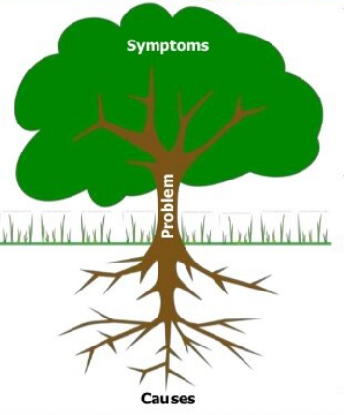
Health Equity
Structural inequities and racism play large role in determining health and opportunities for health and wellbeing
Considering inequity important even in a town without much diversity
Use Racial Justice Reframing Questions
Who benefits?
Who is harmed?
Who influences?
Who decides?
What are the unintended consequences?

Slide 22
Practical Age- and Dementia-Friendly Examples
Specifically include older adults in community-wide events held in accessible venues
Neighbor support for small repairs through Village to Village networks or Senior Center
Ensure that online town board meetings are always close captioned and that you have adequate microphones and audio boosters for in-person public meetings
Ensure people know of the existing resources like FRTA Access
Install benches along popular town walking routes, formal or informal
Use your Town newsletter to share information on age-specific resources and supports
Provide first responders with special training to better serve older adults living with dementia or other age-specific issues when in an emergency
Establish a buddy system in schools to encourage intergenerational interacting and appreciation.

Slide 23
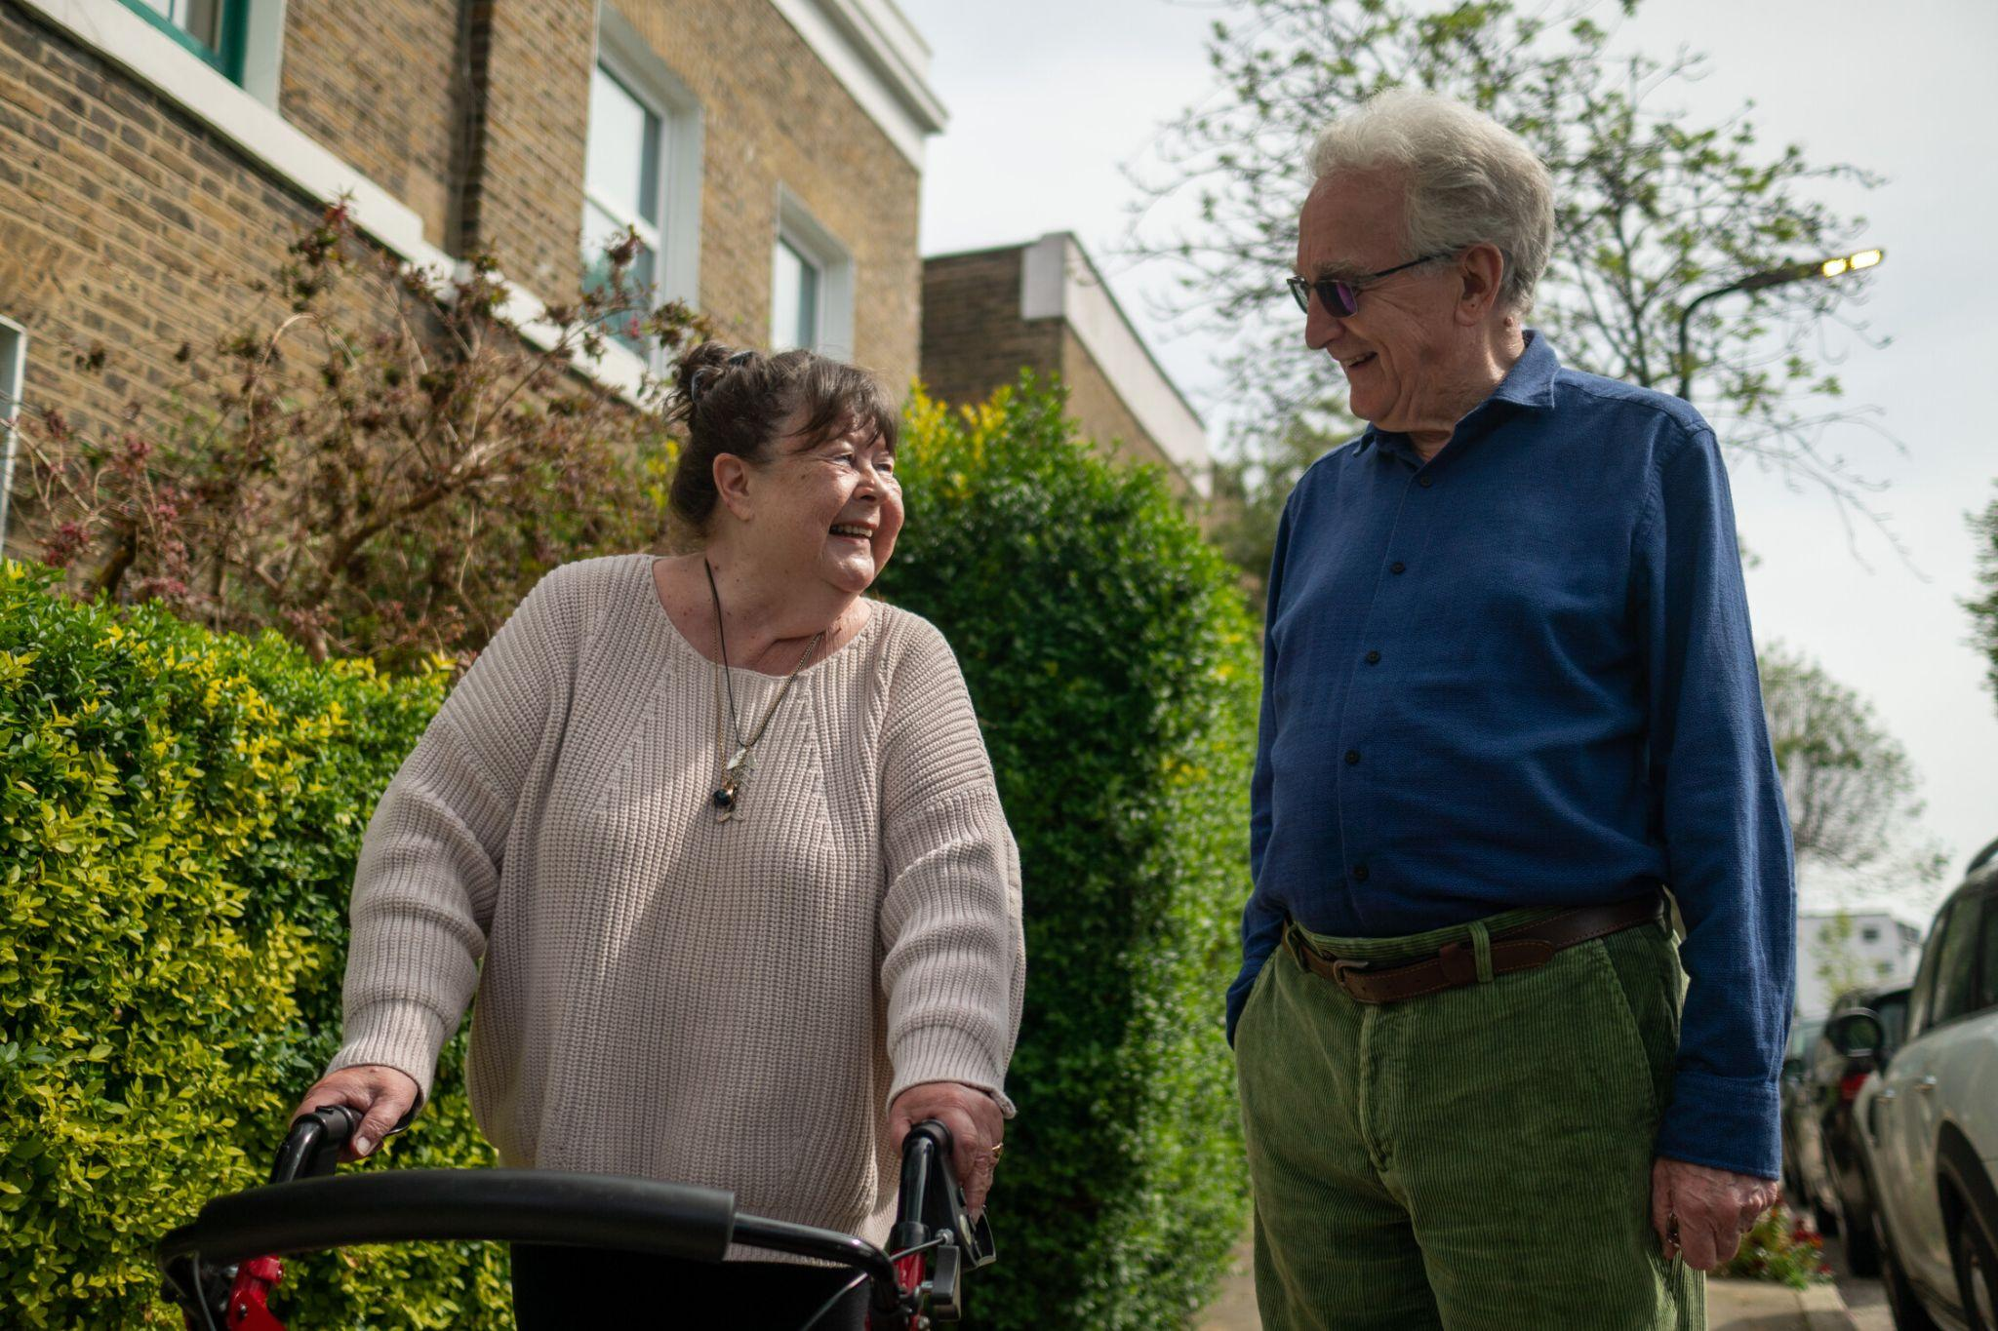
Questions?

Slide 24
Contact Us
Carol Foote
Age- and Dementia-Friendly Program Manager
LifePath
cfoote@lifepathma.org
www.lifepathma.org
Meg Ryan
Public Health Nurse
Franklin Regional Council of Gov’ts
mryan@frcog.org
www.frcog.org

